Slide 1
Unit 6
Let's go shopping!

Slide 2
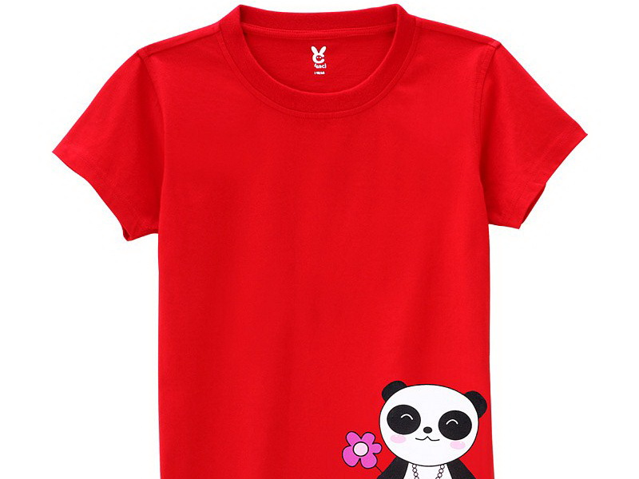
T-shirt

Slide 3
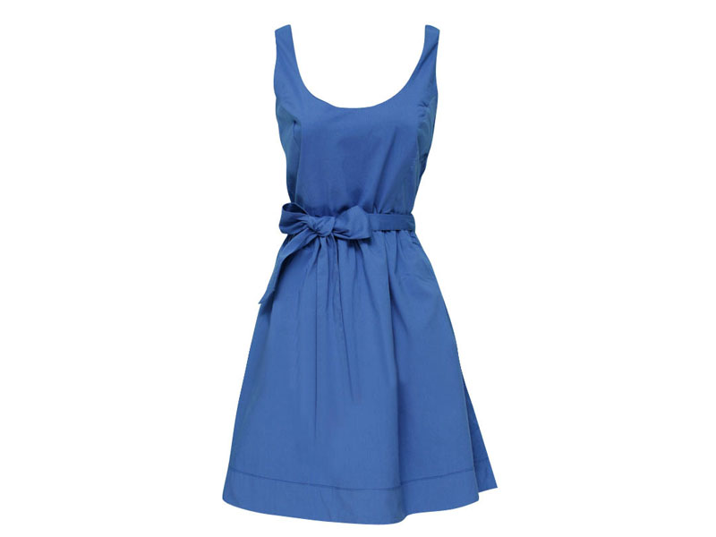
dress

Slide 4
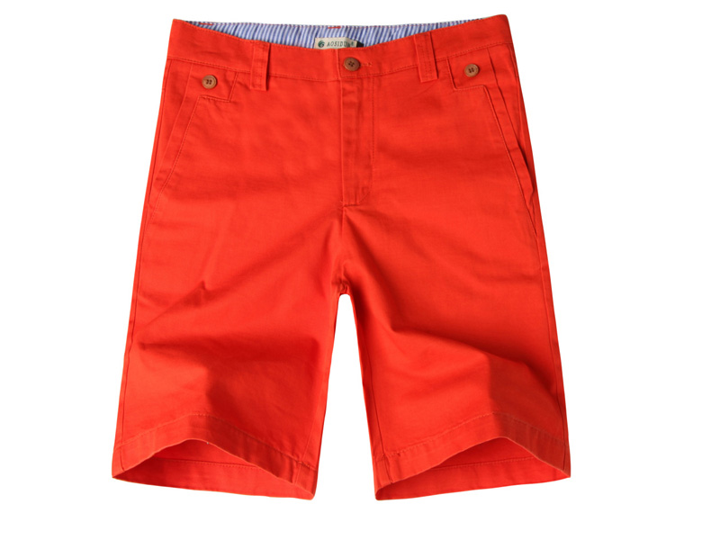
shorts

Slide 5
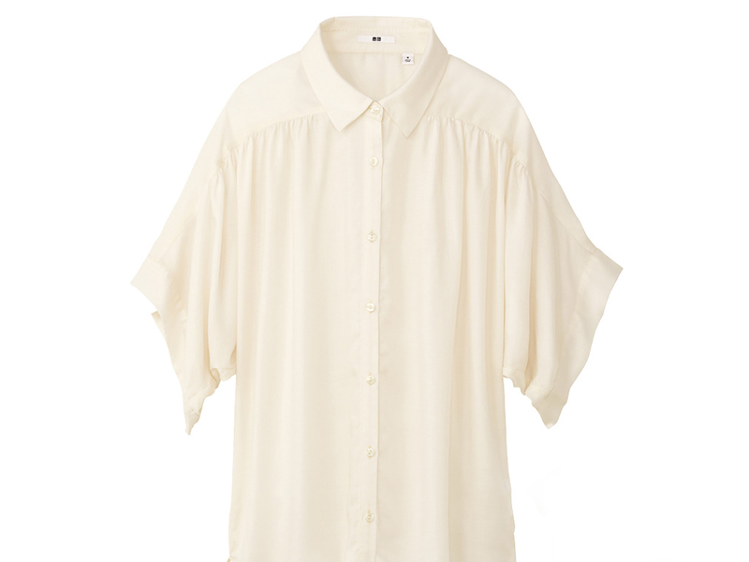
blouse

Slide 6
Practice!

Slide 7
看图填单词：
___________________
___________________
___________________
___________________
T-shirt

Slide 8
___________________
___________________
___________________
___________________
dress

Slide 9
___________________
___________________
___________________
___________________
shorts

Slide 10
___________________
___________________
___________________
___________________
blouse

Slide 11
猜猜哪个单词消失了？
T-shirt
blouse
dress
shorts

Slide 12
T-shirt
dress
blouse
shorts

Slide 13
shorts
blouse
T-shirt
dress

Slide 14
dress
blouse
T-shirt
shorts

Slide 15
Thank you!

